Slide 1



Greedy Snake
Small Team Project - Group 9
Members:
Bo Sun bxs863
Gregory Field gxf894
Hao Feng hxf879
Lixuan Dai lxd901
Shengdong Yan sxy777
Tutor: Joe

Slide 2
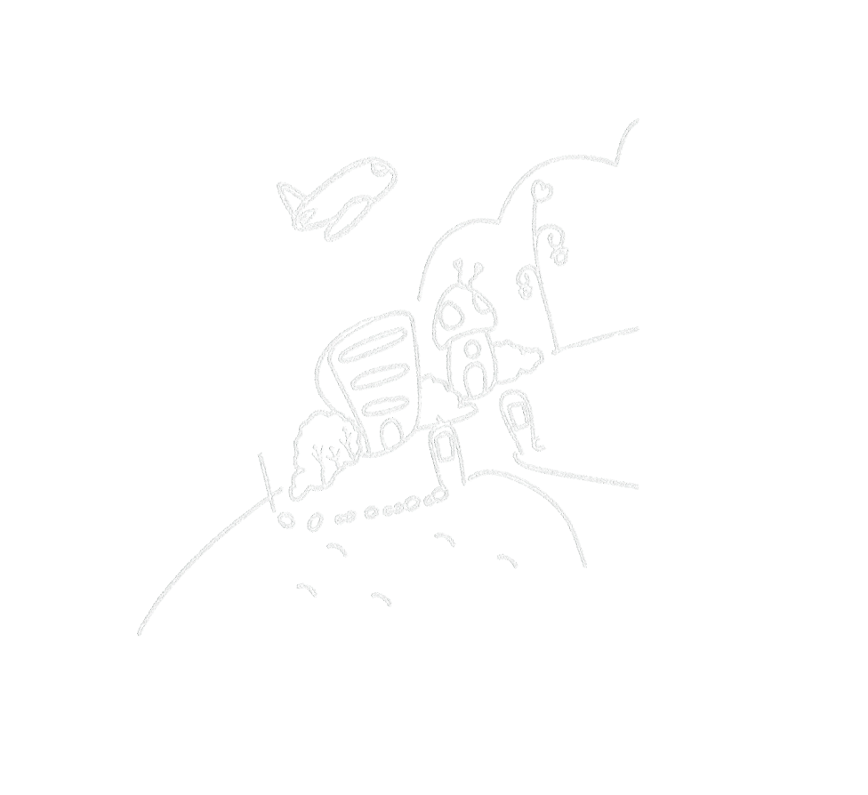
Project Topic
Background
Description

Slide 3

Background
Chatroom is the most traditional network application.
Online game is one of the most pupolar network applications and we all like play online games very much.
Finally, we decided to make a game fighting platform, which combines chatroom and online game together

Slide 4
Description
Users Can:
Create an Account, with a Username & Password
View a List of Other Online Users
Send & Receive Instant Messages
Send Game Invitations
Play a Game with Other Users
Notes:
Here is a description of the possible actions that our system allows a user to do

Slide 5

Architecture
※ Whole architecture
※ Server-Client
※ Game

Slide 6
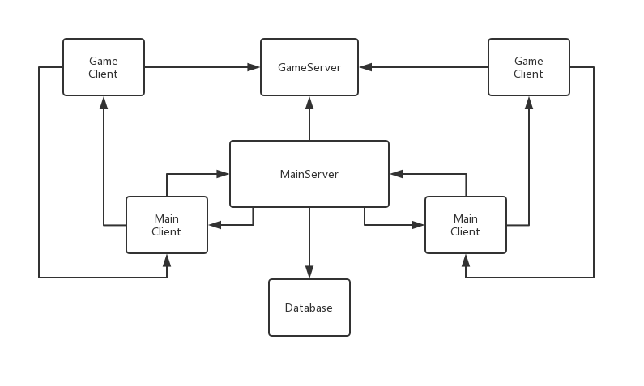
System Architecture
Notes:
This is the architecture of our system, it shows how two users are connected to the system. As you can see our system uses two servers, two clients and a database.

Slide 7
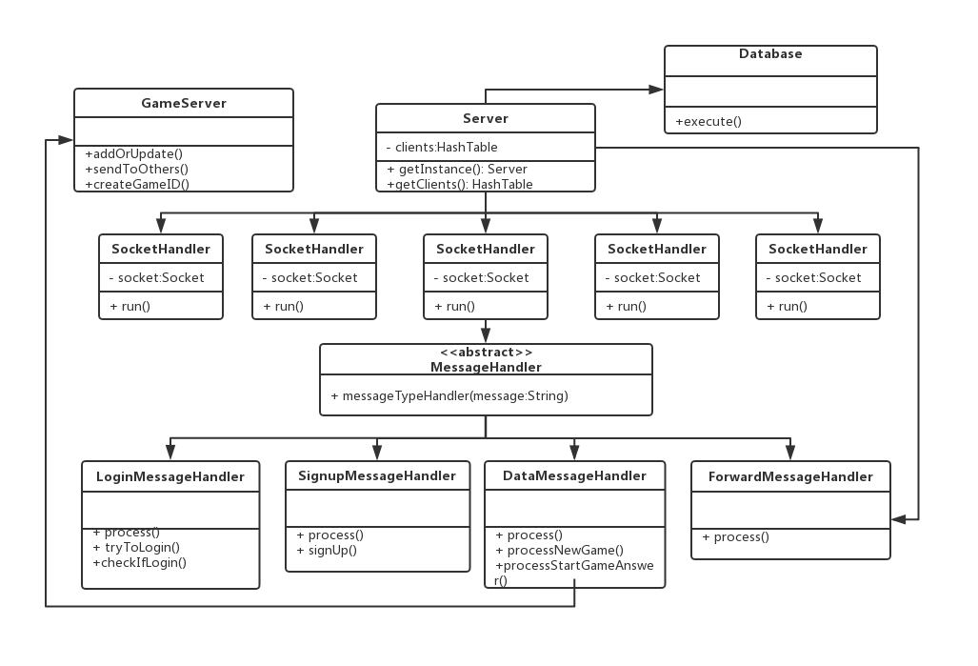
Servers Architecture
Notes:
This is the overview of our servers architecture, messages are handled by four classes, login and sign up are used for users to access the system. Data message hanlder either handles input messges from the user or for game ivitations and their response, forward message sends the messages to all clients

Slide 8
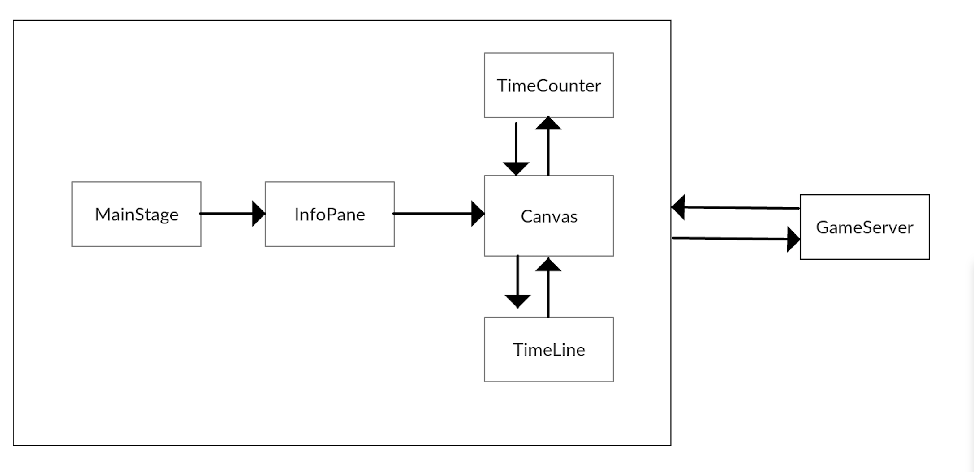
Game Architecture
GameClient
Notes:
This is games architecture, the application opens a the mainstage, which loads the info pane that serves as a waiting screen for the game, after both users have indicated they are ready to play the canvas is then loaded to the mainstage. The game time begins and is repeatly updated to the canvas, the game server also sends and receives data from the game.

Slide 9

Team Organization
※ Task Assignment
※ Version control tools
※ Process

Slide 10
Task Assignment
Servers:
Client:
Game:
Database:
GUI:
Bo Sun
Lixuan Dai, Greg Field,
Shengdong Yan
Hao Feng
Lixuan Dai, Greg Field

Slide 11

VERSION CONTROL TOOLS
Before Feb 26
After Feb 26
We used github until gitlab avaliable
We moved all our github work to gitlab Group9 repository

Slide 12

Process
We met at least once every week.
We have worked together for 25.5 hours
Every time each of us made a progress, we would update our work to gitlab.
We have made 7 branches and 99 commits.

Slide 13

Subsystems
※ Server
※ GameClient
※ Database
※ GUI

Slide 14




Server
What should the server have?
Multi-Users
Cooperation
Stability
Reusability
The server should serve for multi-users at the same time.
The server consists of two parts (TCP and UDP), and they can run together
The server should have the ability to handle the disconnection.
The server should handle other task if the task follows a certain rule.

Slide 15
Server
What does the server provide?
All
Findable
Expandable
Unity
All the requirements have been implemented.
The server will always let the clients get its newest IP and Port number.
The server can handle multiple players even more than 2 players.
All the message transfered between the server and the client is organized with JSON.

Slide 16
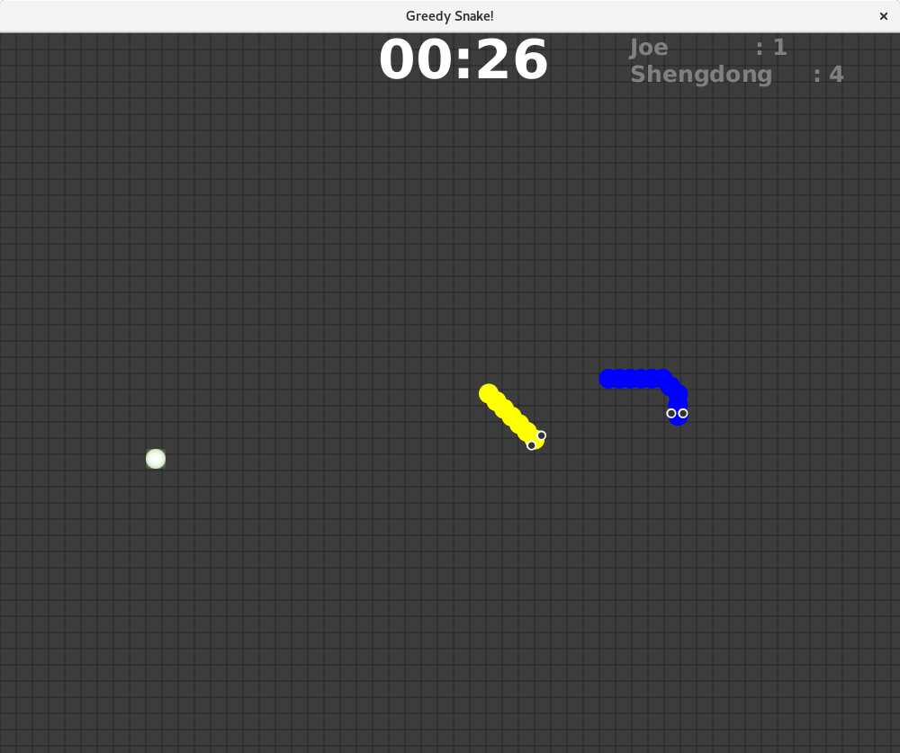

Game
TimeCounter: Thread
Countdown from 120 and sleep 1000(ms) every time.
ScoreBoard: Labels
Read the name and score of another player from server
Node: Oval (x,y)
Every time got by one snake, it will regenerate randomly in another place
Snake(head): Oval(x,y)
Master is the bule one, snake cannot collision the border and another snake.
SnakeBody: LinkedList<Point>
Trace the snake and can grow

Slide 17
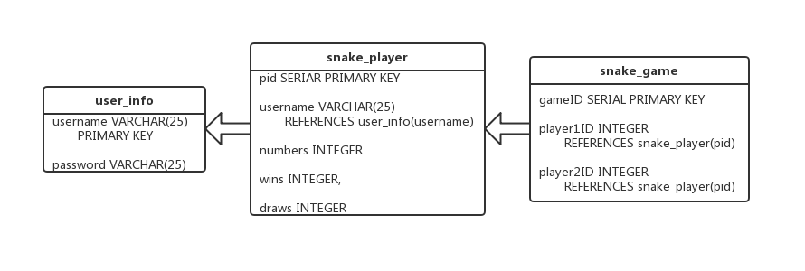
Database
The database uses 3 tables to store information for the System
User_info table stores the users information, which is updated when the user signs up.
Snake_player stores information relating to a users playing history of snake.
Snake_game stores information relating to a snake game.
Notes:
The username is used as the primary key for user_info and snake_player, the primary key for snake game is the gameID

Slide 18
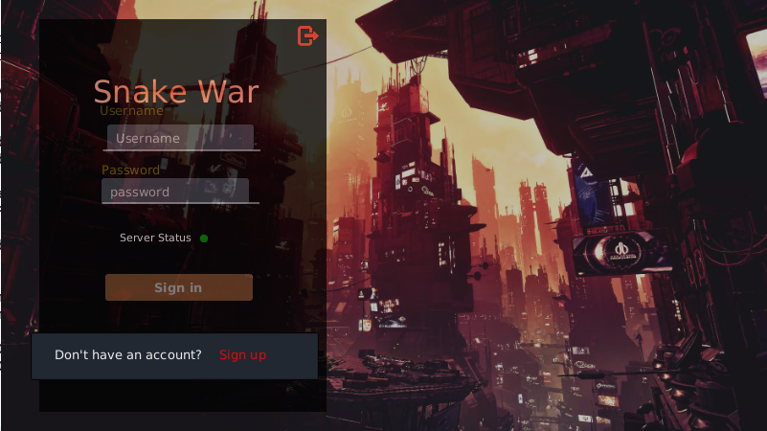
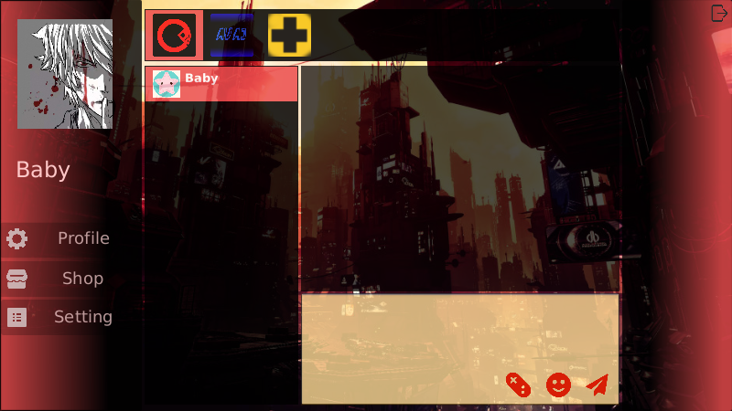
GUI
What should the GUI have?
-Unified style
-Beautiful
-Clear
- Upgradable
Using same theme color and background image to build a Cyberpunk style GUI.
Using CSS to set the style of listview and buttons.
Main function is put in a obvious place and highlighted.
Leave interface for future extension.

Slide 19

Tests & Evaluation
※ Tests
※ Evaluation
※ Further

Slide 20
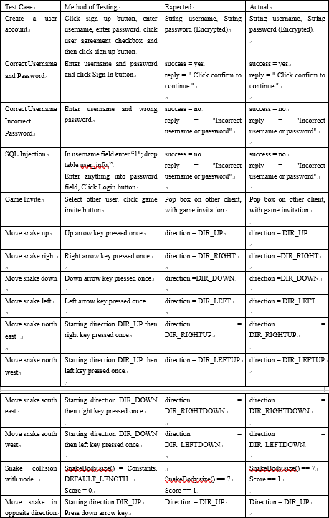
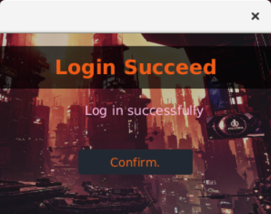
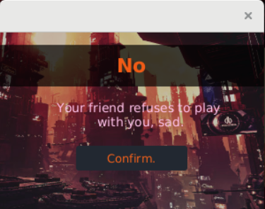
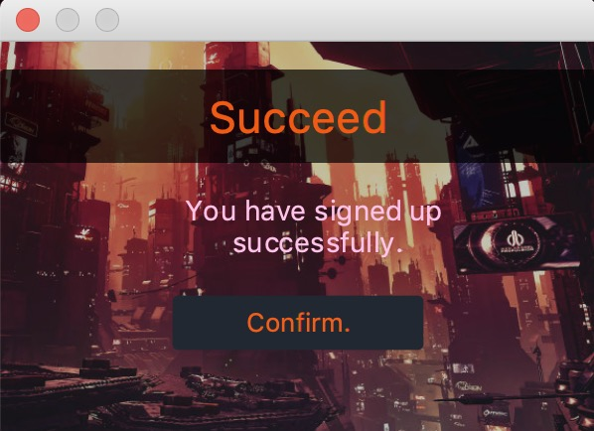
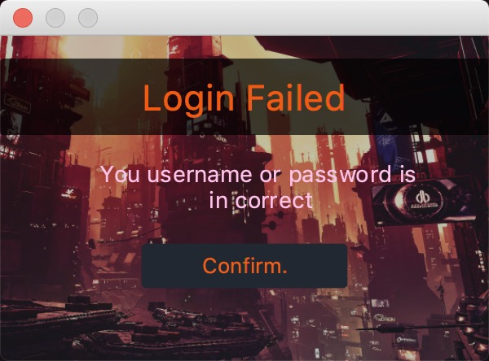
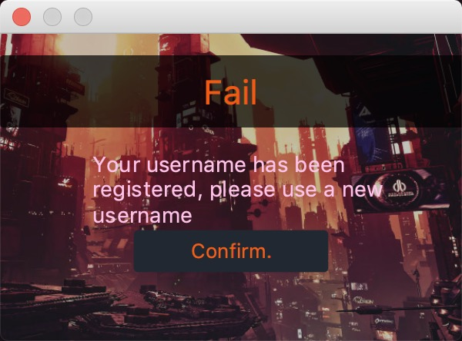
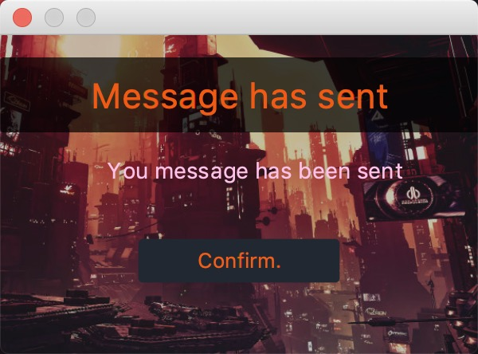
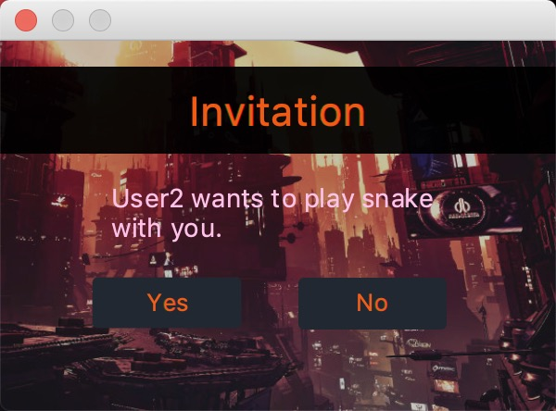
Tests
During development we used logging to test our system
We designed tests for scenarios where the user inputs incorrect information to ensure the system reacted appropriately
Our tests also ensured that the client would be able to control
their snake
Notes:
We used logging to print statements when testing a debugging our system, Our tests would allow us to know when the client had a succesfully connected to the server, whether messages had been sent or received. We manually tested the system extensivly to ensure that system behaved as intended and wouldn't give unexpected results.

Slide 21
Evaluation
Our system performs all the functionality that the project first set out to acheive
The system can successfully send and receive messages between clients
Two users are able to play a game

Slide 22
Future Improvements
Some improvements we would have liked to implement to the system are:
Adding multi-player games
Adding AI to be used for other players in the game
Adding more features to the chat room such as emoji's and Image sending
Adding game store for users to download
Perfect the database and make the whole software more stable
Adding profile and setting which allows player to modify their personal infomation and system setting

Slide 23
Thank you !

